Slide 1

Note: The data and information in this document is reflective of a hypothetical situation and client. This document is to be used for KPMG Virtual Internship purposes only.
Sprocket Central Pty Ltd
Data analytics approach
Saransh Gupta, Junior Consultant

Slide 2
Note: The data and information in this document is reflective of a hypothetical situation and client. This document is to be used for KPMG Virtual Internship purposes only.
Agenda
Introduction
Data Exploration
Model Development
Interpretation

Slide 3
Note: The data and information in this document is reflective of a hypothetical situation and client. This document is to be used for KPMG Virtual Internship purposes only.
Introduction
New Customer Targeting
Features to Recommend / Target new customer:
Age Distribution among old and new customers.
Past 3 Years Purchase Percentage on the Basis of Gender.
Job Industry Category Count.
Wealth Segment among Age Bins.
State wise Car owned

Slide 4
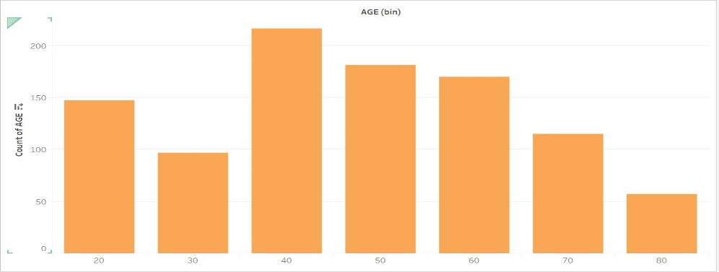
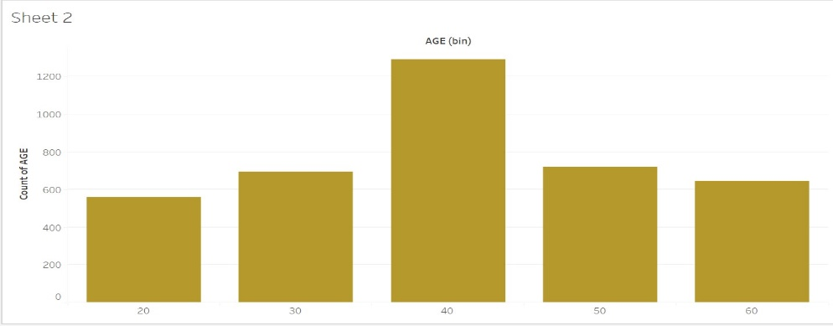
Note: The data and information in this document is reflective of a hypothetical situation and client. This document is to be used for KPMG Virtual Internship purposes only.
Data Exploration
Age Distribution among old and new customers
More New customers are in the age group of 40-60 Years Old.
Less new Customers in group 25-40 Years Old.
New Customers can be seen in the Age group > 60.

Slide 5
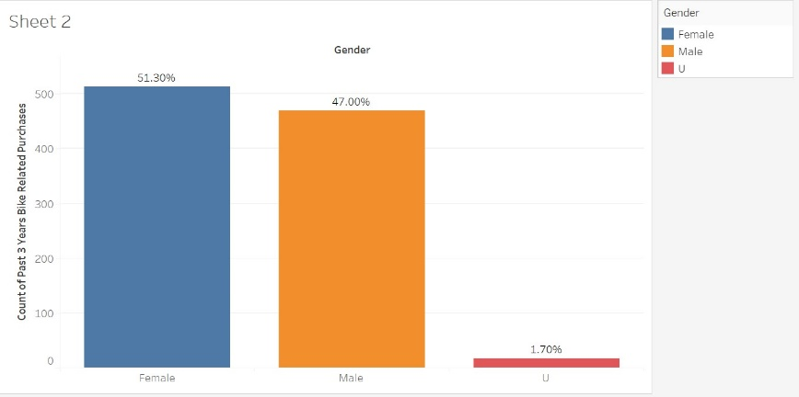
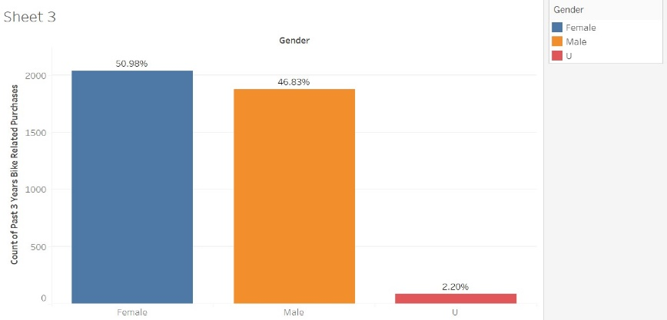
Note: The data and information in this document is reflective of a hypothetical situation and client. This document is to be used for KPMG Virtual Internship purposes only.
Model Development
Past 3 Years Purchase Percentage on the Basis of Gender
In New customer list we can see 51.30% Female Compared to 47% Male.
In Old Customer Data Same pattern is Shown .
We can either Focus on Female Buyer’s Retention or Focus on Male Buyers to Increase Revenue and Sales.

Slide 6
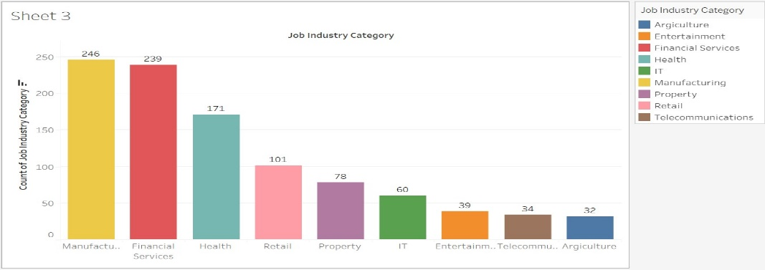
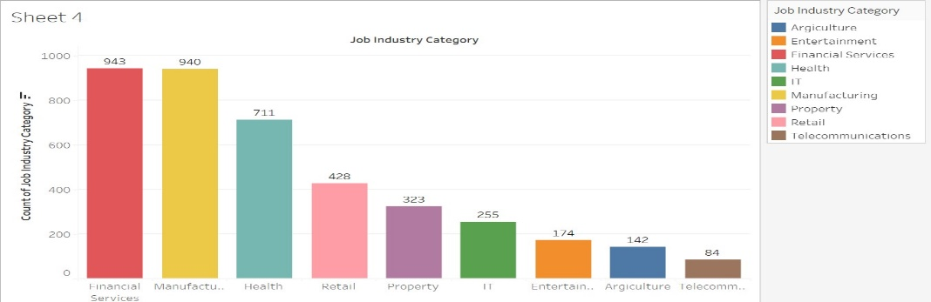
Note: The data and information in this document is reflective of a hypothetical situation and client. This document is to be used for KPMG Virtual Internship purposes only.
Interpretation
Job Industry Category Count
We can See That Job industry category is almost same for both old and new customers.
Top industry for new customer group is:
Manufacturing, Financial Services,Health.
Top industry for old customer group is:
Financial Services, Manufacturing,Health.

Slide 7
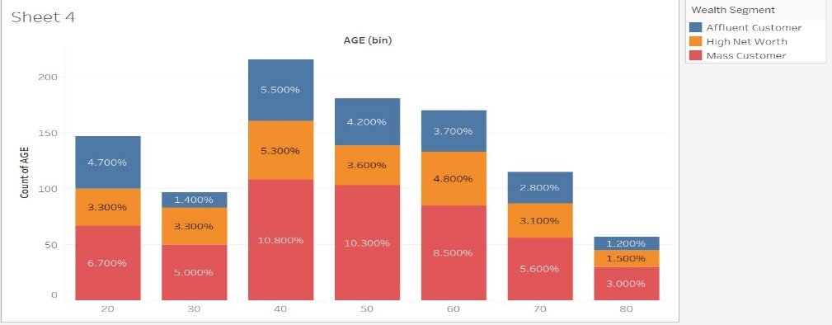
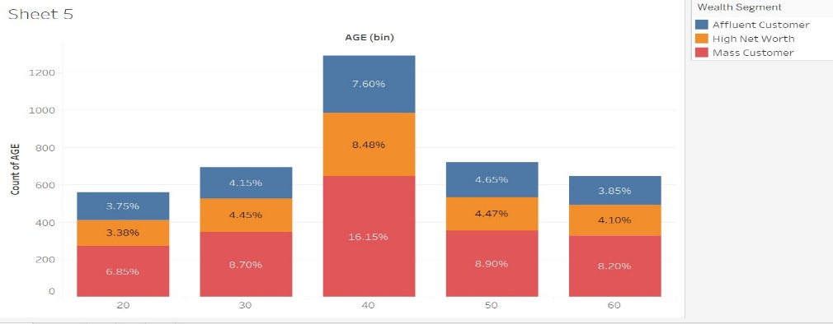
Note: The data and information in this document is reflective of a hypothetical situation and client. This document is to be used for KPMG Virtual Internship purposes only.
Interpretation
Wealth Segment among Age Bins
Mass Customers are the highest percentage buyers among all ages.
Collective Percentage of High Net Worth and Affluent customers is more than Maas Customers.
We should try to Target The above Wealth Segment New Customers.

Slide 8
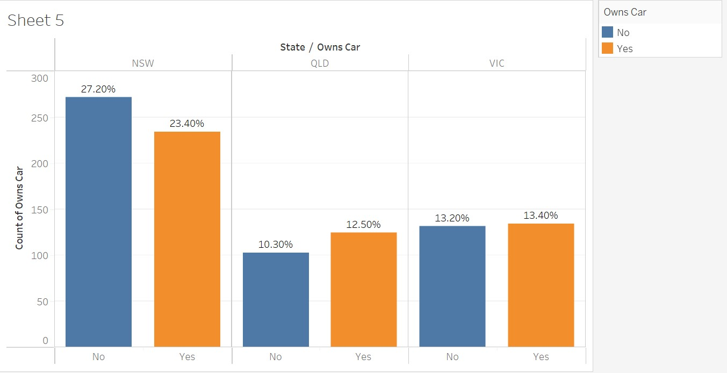
Note: The data and information in this document is reflective of a hypothetical situation and client. This document is to be used for KPMG Virtual Internship purposes only.
Interpretation
State wise Car owned
NSW has more cars Owned by buyers, but also more buyers who don’t have the cars.
VIC is next state with relatively equal car owners and buyers who don’t own the car.
QLD Has 3rd highest car owners with less buyers who don’t own the cars. Its an ideal state to Target the customers.
New Customer Targeting Potential is more at State QLD .

Slide 9
Note: The data and information in this document is reflective of a hypothetical situation and client. This document is to be used for KPMG Virtual Internship purposes only.
Appendix

